Slide 1
Discussion & Lecture Session Sound & Recording Check
Remote participants:
Log into Join.me
Announce yourself and provide your name on the phone and/or in the chat session
For Screen Sharing utilize your computer
For conference call audio utilize your computer speakers and microphone OR dial into the session with your mobile phone
Onsite participants:
Sit in a good spot near the “speaker phone” if possible
Optionally sign into Join.me… but make sure that your microphone and speakers are muted/off
Test recording by starting recording and then stop recording after a few seconds
Check recording sound when video is released by Join.me

Slide 2

Software Engineering Discussion, Lecture, & Lab Eric Pogue
Agenda for Wednesday, January 22nd at 2pm CT
Friendly Conversation Topic
Prework
Sprint Planning
Software Development Models & Lifecycles
Real World Waterfall, Iterative, and Agile
Scaled Agile
Assignment
Lab
Discussion & Questions welcome at any time… please be present with no phones or email during our time together

Slide 3
Friendly Conversation Topic: Web Services, REST, and CORs

Slide 4

Web Services
In a web service, the Web technology such as HTTP—originally designed for human-to-machine communication—is utilized for machine-to-machine communication, more specifically for transferring machine-readable file formats such as XML and JSON.
In practice, a web service commonly provides an object-oriented web-based interface to a database server, utilized for example by another web server, or by a mobile app, that provides a user interface to the end user.
Many organizations that provide data in formatted HTML pages will also provide that data on their server as XML or JSON, often through a web service to allow syndication

Slide 5
REST
Representational State Transfer (REST) is an architectural style that defines a set of constraints and properties based on HTTP. Other kinds of web services, such as SOAP web services, expose their own arbitrary sets of operations.
"Web resources" were first defined on the World Wide Web as documents or files identified by their URLs. However, today they have a much more generic and abstract definition that encompasses every thing or entity that can be identified, named, addressed, or handled, in any way whatsoever, on the web. In a RESTful web service, requests made to a resource's URI will elicit a response that may be in HTML, XML, JSON, or some other format. The response may confirm that some alteration has been made to the stored resource, and the response may provide hypertext links to other related resources or collections of resources. When HTTP is used, as is most common, the operations available are GET, POST, PUT, DELETE, and other predefined CRUD HTTP methods.
By using a stateless protocol and standard operations, REST systems aim for fast performance, reliability, and the ability to grow, by re-using components that can be managed and updated without affecting the system as a whole, even while it is running.

Slide 6

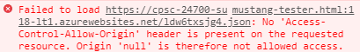
CORS
Cross-Origin Resource Sharing (CORS): CORS is a mechanism that uses additional HTTP headers to tell a browser to let a web application running at one origin (domain) have permission to access selected resources from a server at a different origin. A web application makes a cross-origin HTTP request when it requests a resource that has a different origin (domain, protocol, and port) than its own origin.
An example of a cross-origin request: The frontend JavaScript code for a web application served from http://domain-a.com uses XMLHttpRequest to make a request for http://api.domain-b.com/data.json.
For security reasons, browsers restrict cross-origin HTTP requests initiated from within scripts. For example, XMLHttpRequest and the Fetch API follow the same-origin policy. This means that a web application using those APIs can only request HTTP resources from the same origin the application was loaded from, unless the response from the other origin includes the right CORS headers.
Notes:
https://developer.mozilla.org/en-US/docs/Web/HTTP/CORS
https://www.youtube.com/watch?v=o8puzjzpjqo

Slide 7
Prework

Slide 8

Scrum Process – Sprint Planning
By Dr ian mitchell - Own work, CC BY-SA 4.0, Link

Slide 9
Assignment for Next Class
All sprint 2 activities & assignments are due Sunday night*
Sprint 2 content and prework will be made available by Monday
Notes:
* You have a grace period until 6am CT Monday morning to submit assignments.

Slide 10
Two “Triangular” Models of Software Development

Slide 11
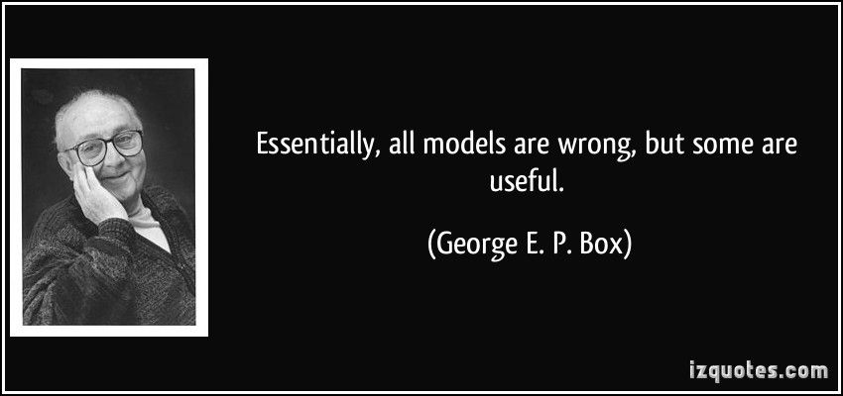
Models

Slide 12
The Virtuous Triangle
Of Software Development

Slide 13
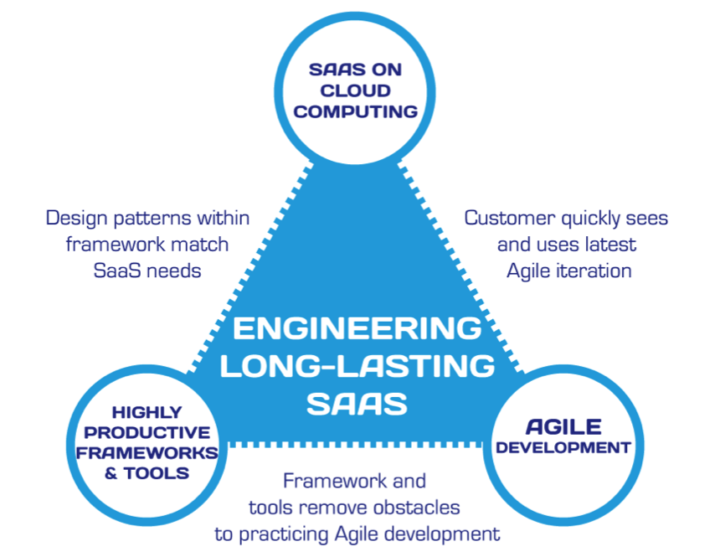
Hosting Technology: Cloud & Software as a Service (SaaS)…
People: Organizations, Domain Knowledge, Customers, Business Process…
The
Virtuous Triangle
Process: Agile, Requirements, Project Management, Prioritization, Portfolio Management, Metrics…
Productivity Technology: Configuration Management, Source Code Management, Automated Testing…

Slide 14
The Righteous Triangle
Of Software Development

Slide 15
People, Process, and Technology
Software Engineering:
People: Teams, Organizations, Processes, Engagement, Dedication, Leadership, Experience, Domain Knowledge… “the (mythical) Business”
Process: Waterfall/Iterative/Agile, Portfolio Management, Project Management, Funding, Prioritization, and Metrics
Technology: Usability, Architecture, Cloud Hosting, Frameworks, Languages, Scriptable Infrastructure, Configuration Management, and Automated Testing
Notes:
Eric’s View

Slide 16
The Right-eous Triangle of Software Development
People & Organizations
Technology & Tools
Process & Roles

Slide 17
Real World Waterfall, Iterative, and Agile

Slide 18
The Righteous Triangle of Software Development
People & Organizations
Technology & Tools
Process & Roles

Slide 19
What is the primary impact of using an Agile SDLC and an application’s Architecture?
Notes:
Utilizing an Agile Software Development Lifecycle forces an application’s (or system’s) architecture to demonstrate validity much much earlier. Failing sooner can save a massive amount of money.
However, sometimes it can be also be immensely painful to understand where you are in a project. This can be one of the challenges when moving to Agile.

Slide 20
The Physics of Finding & Fixing Defects
The cost of fixing a defect goes up exponentially the more time the defect exist in an application. Defects can be found in any of the follow phases:
Unit Testing: developer testing their own code (minutes or hours to fix and retest)
Integration Testing: development team testing their full code (hours or days)
System Testing: multiple development teams testing a full system or systems (days or weeks)
User Acceptance Testing: in a production like environment with system users (days, weeks, or months)
Production: in production found by real users (weeks, months, years, or maybe never)
Performance testing: testing performance at the Unit, Integration, System level, and/or in production (depends)
Validation testing: historically on been found primarily in production

Slide 21
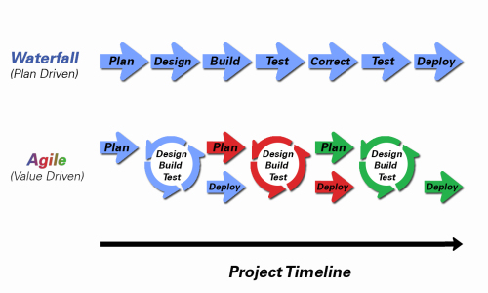
Object-Oriented Programming within Various Development Methodologies
Notes:
Development Methodology and Software Development Lifecycle (SDLC) are often used interchangeably.
The Iterative development methodology is not depicted here as even the mainstays and inventors of the Iterative development methodology seem to be moving toward agile. Plus as Waterfall “holdouts” move, they seem to be moving directly toward Agile. Can you start to see my biases?
Development Methodologies (SDLCs) are a future Bonus Topic. There are several optional slides t the end of this deck. Let me know if you would like to have a more formal overview of the topic as part of this class. I have a passion in this area.
Object oriented-programming concepts/practices evolve and reprioritize depending on the development methodology.
For example, in Waterfall (as well as in Iterative) object-oriented design often play a critical role in the (big upfront) design activities. UML diagrams and project artifacts are often important to the overall project success. (opinion) Practical reality has been that these design artifacts often do not reflect the actual implementation and are rarely maintained or updated.
The Agile practitioners do not reject these design artifacts. However, the focus on shorter time horizons, evolving architecture, and working code changes the value proposition for object-oriented practices to more focus on the build, test, enhance activities.

Slide 22
Where does RUP and Spiral fit in the industry?
Notes:
No one has talked about Spiral for a long time.
RUP still has supports but most have moved to Agile or Scaled Agile.

Slide 23
Waterfall vs Iterative vs Agile
 | Waterfall | Iterative | Agile
References | United States Department of Defense: DOD-STD-2167A (1985) | Rational Unified Process (RUP) Open Unified Process | Scrum Kanban Scaled Agile Framework (SAFe)
Priorities | Planning and predictability | Architecture, modeling, and efficiency through early detection & fixing of issues | Responsiveness to feedback, efficiency through engineering practices, early detection & fixing of issues
Principles | Execute phases sequentially: Requirements Analysis Design Coding Testing and Operations Define and commit to Scope, Cost, and Timeline “early” Implement strict Change Control | Develop and test iteratively Manage requirements Use components Model visually Verify quality Control changes | Develop, test, deploy, and release iteratively Capture lightweight near term requirements Empower teams Allow requirements to evolve but maintain fixed timelines Apply engineering practices and systems thinking (e.g. TDD) Integrate early user feedback into remaining plan Maintain a collaborative approach between all stakeholders
Notes:
The views on testing and change management have changed dramatically as organizations have moved from Waterfall to Iterative to Agile development lifecycles.
Successful Agile (and Iterative) Development REQUIRES better application design, development techniques, and testing practices.
Testing and lack of defects are not the end goal. A higher quality more usable more cost effective product is the goal.

Slide 24
First Look – Scaled Agile

Slide 25
Recall Agile & Scrum

Slide 26
Agile Manifesto
“We are uncovering better ways of developing software by doing it and helping others do it. Through this work we have come to value:
Individuals and interactions over processes and tools
Working software over comprehensive documentation
Customer collaboration over contract negotiation
Responding to change over following a plan
That is, while there is value in the items on the right, we value the items on the left more.”
Notes:
This was kind of “hippy-ish” and egalitarian in its day… quite controversial in its day
“Everyone is a team member and is responsible for the work getting done”… we don’t need no titles or positions… self-organizing… we will make our own commitments… transparency (let’s share the information)… flexible/organic teams, organic architecture (minimal documentation/standards)… no contracts (let’s talk it over)
The flip side:
We will actively and voluntarily play important roles on our team
The rules (rituals) that we do have… we WILL follow
We will create, demo, and release working software/products
We will utilize practical processes, tools, documentation, and planning
When we make commitments, we will live up to those commitments… as a team (“No winners on a losing team, and no losers on a winning team”)
We will be responsive and continuously improve (Retrospectives)
We will be transparent with how WE work and share our information

Slide 27
Agile Manifesto
Agile Team Commitments:
Everyone is a team member and is responsible for getting the work done (we don’t need titles and positions)
We will actively and voluntarily play important roles on our team
The rules (rituals) that we do have… we WILL follow
We will create, demo, and release working software products
We will utilize practical processes, tools, documentation, and planning
When we make commitments, we will live up to those commitments… as a team (“No winners on a losing team, and no losers on a winning team”)
We will be responsive and continuously improve (Retrospectives)
We will be transparent with how WE work and share our information
Notes:
Agile Team Commitments
Everyone is a team member and is responsible for the work getting done
we don’t need no titles or positions
self-organizing
we will make our own commitments
transparency (let’s share the information)
flexible/organic teams, organic architecture (minimal appropriate documentation/standards)
no contracts (let’s talk it over)

Slide 28

Scrum Discussion from Introduction to Scrum - 7 Minutes YouTube video [link]
Notes:
Other roles exist like developer, tester, etc.
Individuals are expected to play multiple roles as needed.
Three Artifacts:
Product Backlog
User Stories
Burndown Chart
Three Rituals:
Sprint Planning
Daily Scrum
Sprint Review or Retrospective

Slide 29
Scrum Roles, Rituals, and Artifacts
Three Roles:
Product Owner
Scrum Master
Team Member
Three Rituals:
Sprint Planning
Daily Scrum
Sprint Review or Retrospective
Three Artifacts:
Product Backlog
User Stories
Burndown Chart

Slide 30
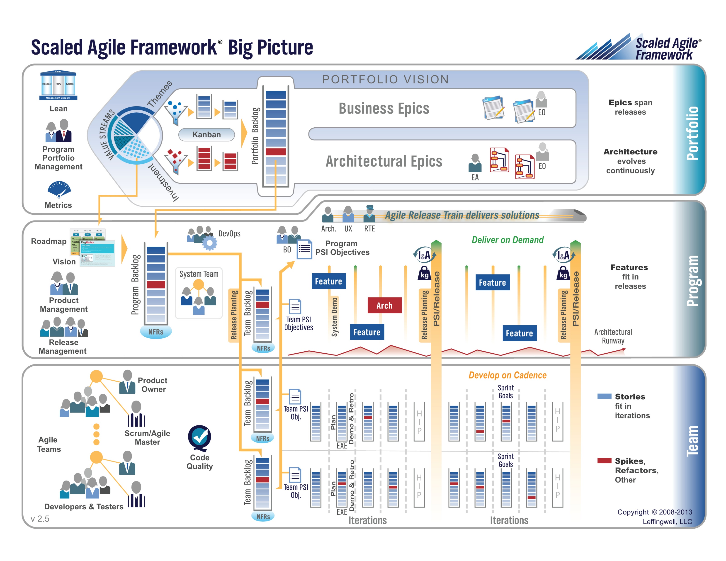

Slide 31
Wrap-up and Final Questions/Comments

Slide 32
Break & End of First Recording

Slide 33
Lab
As A Group:
Optionally Complete DB2
Review Course Material
Review Sample Code
HelloWorld Plus on Azure with Git/GitHub

Slide 34
End of Session & Recordings

